Slide 1
Literature Review

Slide 2
1- Distilling the knowledge in a neural network
Problem: Deploying large models is computationally expensive
Solution(s):
Paper suggests a compression technique using distillation
Paper also suggests a new type of ensembles, specialists, that can be trained rapidly and in parallel

Slide 3
Distilling the knowledge in a neural network (cont.)
Distillation: Have the teacher model output a soft set of targets, this is what the student attempts to learn
Method:
Increase the temperature of the SoftMax function of the teacher, have the student learn the probabilities
You can also combine learning soft probability distribution and hard targets by combining their cross entropies
Results:
Using soft targets retains the information while also regularizing the model
In MNIST and Speech Recognition tests, the distilled model did equally or better than the baseline models
In MNIST, performance did not drop when class labels for some points was removed and the bias adjusted

Slide 4
Distilling the knowledge in a neural network (cont.)
Specialists: Have an ensemble of one general model and many specialized models that learn a subset of classes that are confused with each other
Method:
Apply a clustering algorithm on covariance matrix of the predictions of the general model
Results:
Specialists train extremely fast
Adding specialists increases accuracy
The more specialists there are covering a model the higher the accuracy improvements

Slide 5
2- Deep Compression
Problem: neural networks are computationally and memory intensive
Solution(s):
Paper suggests deep compression to reduce storage and computation requirements while retaining accuracy
Deep compression: pruning, quantization and weight sharing, followed by Huffman coding
Results:
Pruning and quantization together allows you downsize to 3% of the original size without accuracy loss
Speed and energy by pruning: 3-4x speedup, 3-7x less energy

Slide 6
Deep Compression (cont.)
Pruning: Reduces number of connections in a neural network
Method:
All weights below a threshold are removed
Retrain the remaining sparse weights to get the final weights
Store as a compressed sparse row format, the index difference instead of position
Results: reduces number of connections by 9-13x

Slide 7
Deep Compression (cont.)
Quantization and weight sharing:
Reduces the number of bits required to represent each weight
Have multiple connections share the same weight
Needs a codebook that stores the indices of each connection's weight to its cluster, but causes negligible overhead
Method:
K means clusters the weights, all weights in each cluster then take the value of the centroid
Results: reduce number of bits from 32 to 5

Slide 8
Deep Compression (cont.)
Huffman coding: Lossless data compression method that stores the weights
Total compression: 35 to 49x without loss of accuracy

Slide 9
3- MobileNets
Problem: Create an architecture lightweight and computationally inexpensive enough to run on mobile and embedded applications
Solution(s):
Paper suggests depth wise separable convolutions and 2 hyperparameters that tradeoff latency and accuracy
Results and experimentation:
Fine grain recognition, large scale geolocation, face attributes, object detection, face embeddings, accuracy remained constant or slightly decreased for a million parameter decrease
Hyperparameters smoothly decrease accuracy as they increase

Slide 10
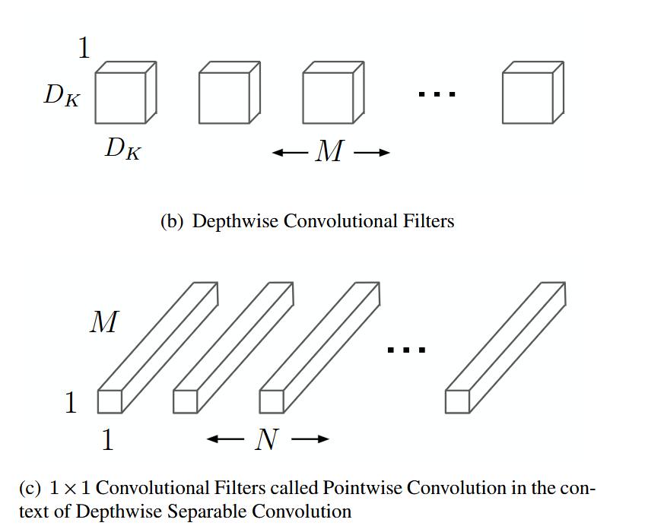
MobileNets (cont.)
Depth wise separable convolutions:
Depth wise convolutions that applies a filter onto each channel
Followed by pointwise convolutions that combines the outputs
This splits the spatial and channels convolutions
Results:
Mobile net (3x3 filters) reduces computation by 8-9 times than standard convolutions, with only a small reduction in accuracy

Slide 11
MobileNets (cont.)
Hyperparametrs:
Width multiplier (a):
Applied to the input and output channels
Reduces computation cost and number of parameters by a²
Resolution multiplier (p):
Applied to the input image
Reduces computational cost by p²

Slide 12
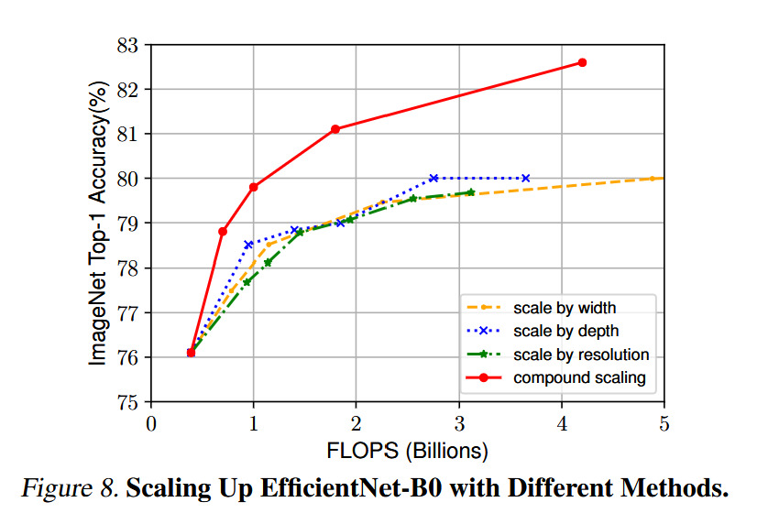
4- EfficientNet
Problem: scaling models to increase accuracy also causes significant increase in computational requirements
Solution(s): Paper suggests a new scaling method, compound scaling, that can lead to better performance at lower scaling levels
Results:
8x smaller and 6x faster than existing ConvNets while achieving Top accuracies

Slide 13
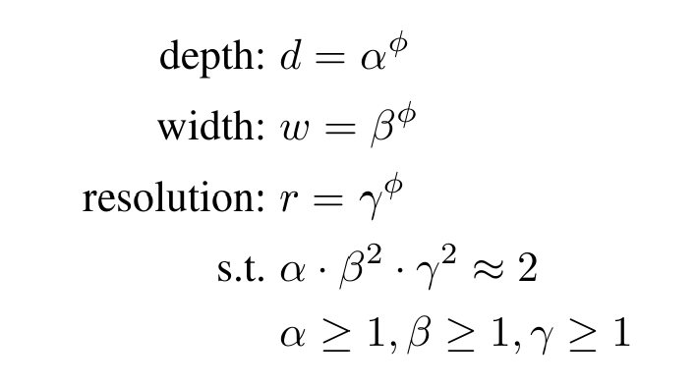
EfficientNet
Method:
This scales the input depth width and resolution simultaneously

Slide 14
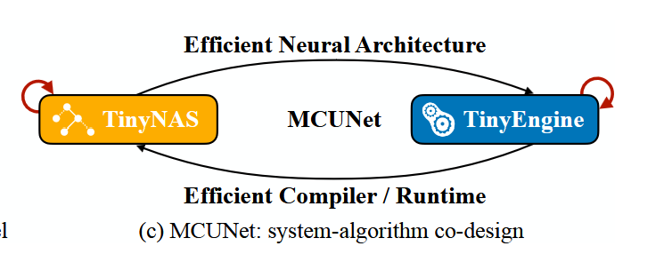
5- MCUNet
Problem: how to deploy neural networks on very small devices with limited resources
Solution(s):
Paper suggest addressing both the model and inference simultaneously
Results:
Reduced the memory usage by 3.4×, and acceleration of the inference by 1.7-3.3× compared to TF-Lite
Achieves >70% accuracy on ImageNet when run on an off the shelf commercial microcontroller

Slide 15
MCUNet (cont.)
TinyNAS:
Neural architecture search that finds the model that fits the constraints while also optimizing FLOPS
TinyEngine:
Inference engine designed for the specific hardware
Generates optimized C code to speed up runtime
Reuses memory since layers don’t run simultaneously, optimizing memory usage
Uses in place depthwise convolutions where channels are outputted are placed in the no longer needed input channels

Slide 16
Deep learning experience
Tensorflow/Keras deep learning models: Classification of EEG signals, images, and data
EEG signal classification model development:
Experimented with research inspired EEG architectures, including: ATCNet models, CNN/TCN blocks, multi head attention, EEG preprocessing methods, to classify different motor imagery conditions
Fake social media account detection end to end system:
Developed an ML pipeline with preprocessing, model experimentation selection, AutoML, ensemble experimentation, explainability, experiment tracking and versioning, and Flask/Docker model deployment on the cloud.
Other Projects:
CNN for sign language recognition, real time facial recognition attendance system, Poisonous mushrooms classification

